Slide 1
Ensemble Classifier
Nicole Buleza, Anna Lu, Keyur Shah
ECEST480/680 Winter 2017

Slide 2
About the Data
Directory | # Files
full | 1801
full_truth | 40
genus | 1904
genus_truth | 40
species | 1906
species_truth | 40
subspecies | 1822
subspecies_truth | 16
Total truth files: 136
Total files: 7433
Notes:
Anna

Slide 3
File Format
TaxID Number_of_reads Relative_abundance rank Name
28216 50000.00000 0.04167 class Betaproteobacteria
Notes:
Anna

Slide 4
Method
Comparing Relative Abundances
For each tool
For each taxa
Histogram of relative abundance vs taxa (TRUTH)
Histogram of relative abundance vs tool (Tool vs TRUTH)
Question: Do specific tools perform better for relative abundance on specific taxa? Gram positive bacteria? Gram negative bacteria?
Notes:
Keyur Justifying the method

Slide 5
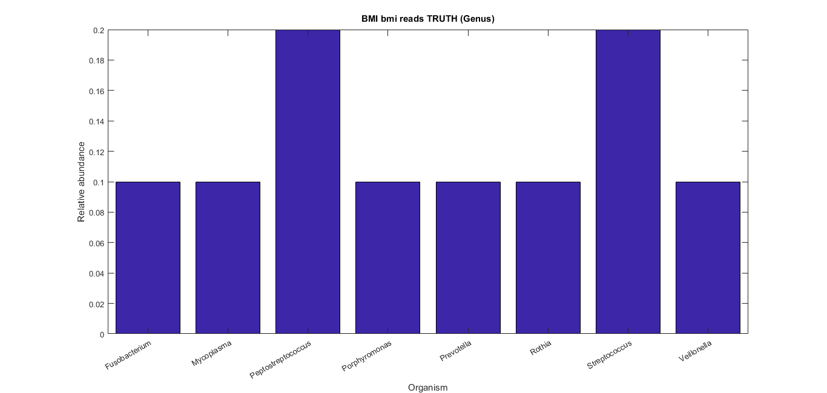
Results
Notes:
Keyur
One sample histogram, label which taxa
Also summarize how many histograms

Slide 6
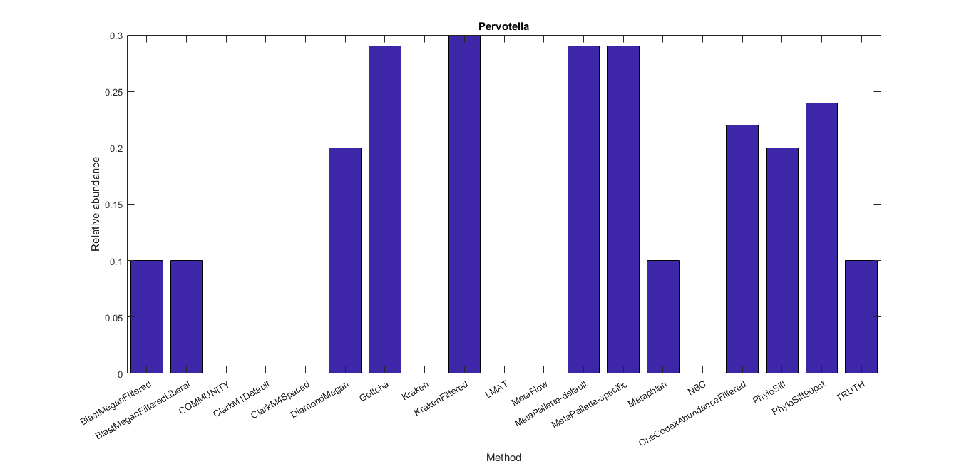
Notes:
Nicole
Pervotella is a genus of gram negative bacteria.
We wanted to test theory that some methods perform better on gram neg or gram pos
From what it seems like, the type of bacteria does play a part (bias exists) - could not test it yet
Pervotella = biomarker of diet and lifestyle

Slide 7
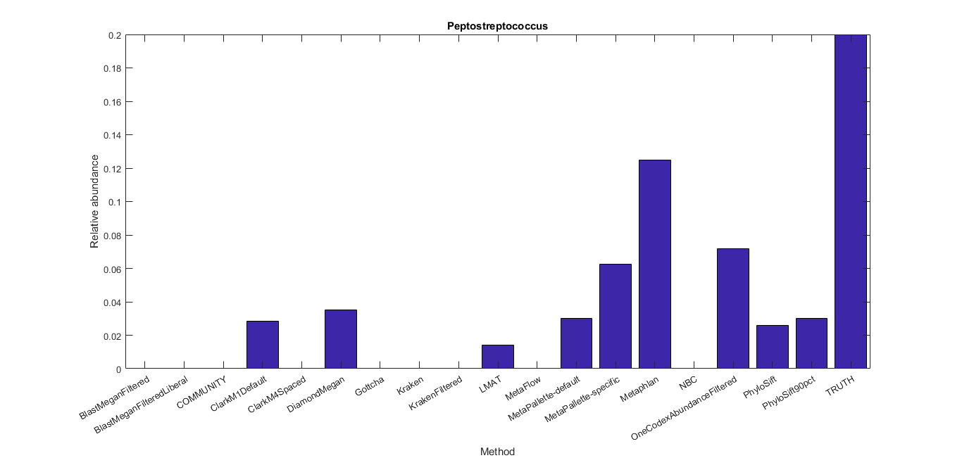
Notes:
Distance between this tool vs truth
Pdist keep L1 manhattan weights higher relative abundances over rarer 0.000001 RAs
Predict relative abundance on a few taxa - per genus

Slide 8
Summary
Methods established and results generated
No evidence of tool bias for either gram negative or gram positive bacteria
Needs further analysis across all TRUTH data
Notes:
Anna

